Slide 1
Topic: Semantic Aware File Converter with Automatic Documentation Generation using Local LLM
REVA Academy for Corporate Excellence (RACE)
Date: 23-03-2026
Shashwath K S
MTech in AI FT-Batch 04
Project Presentation
www.race.reva.edu.in

Slide 2
Agenda
01
Introduction
05
Technology Stack
02
Problem Statement
06
Live Demo
03
Objectives
07
Future Enhancements
04
System Design
08
Conclusion

Slide 3
Introduction
A unified framework for semantic file conversion and automatic code documentation using Python-based parsing and local language models.
Why Documentation?
Prevents loss of critical knowledge by documenting architecture and complex logic.
Helps scale and maintain codebases without time-consuming reverse-engineering.
Reduces technical debt by providing clear context for future changes.
Enables faster onboarding by explaining the system’s purpose and functionality

Slide 4
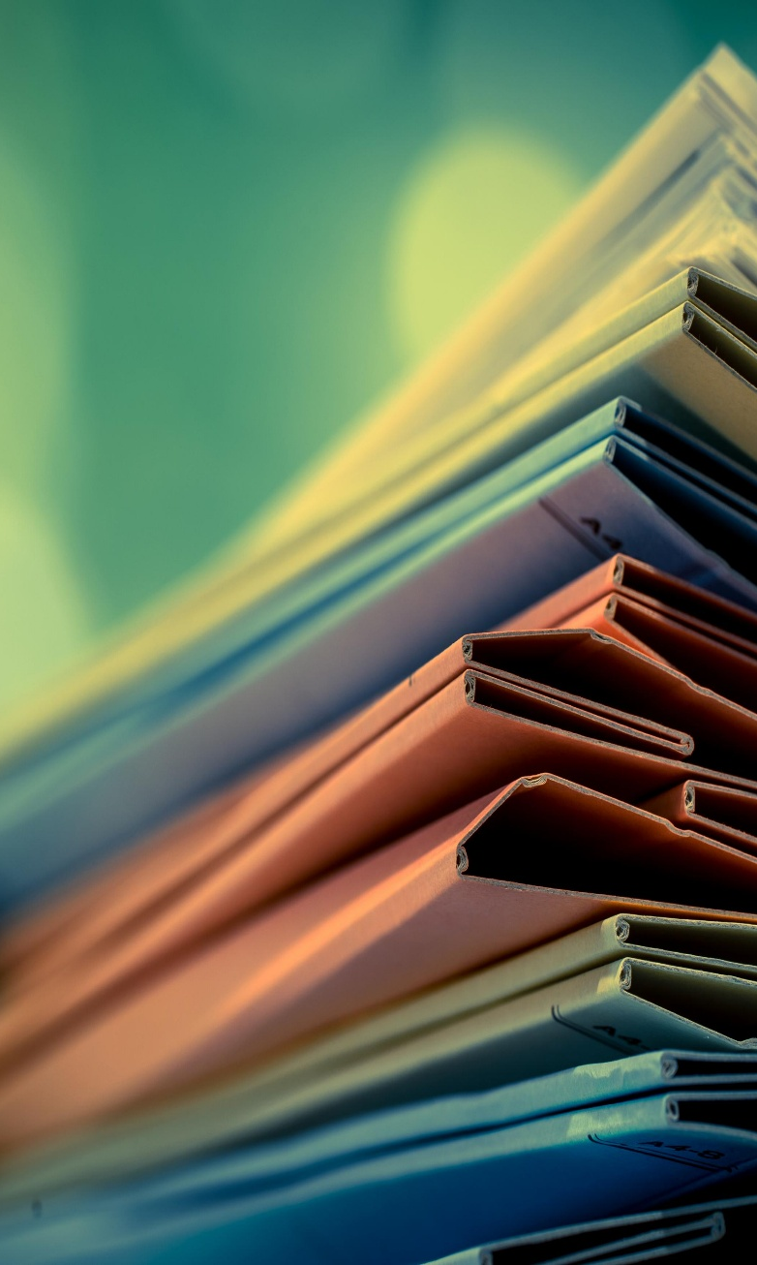
Problem Statement
1. The challenges that we currently face
File converters do not preserve semantic structure and metadata
Manual code documentation is slow and inconsistent
Developers find it difficult to understand large codebases
No single system for both conversion and documentation
2. The solutions we explore in this project
Semantic-aware file conversion to preserve structure
Automatic code documentation using AST analysis
Local LLM based intelligent content processing
Unified workflow for conversion and documentation

Slide 5
Objectives
To design and develop a semantic file conversion system that preserves document structure, metadata, and logical relationships during format transformation.
To implement and integrate an automatic code documentation module that generates context-aware comments using syntax and structure analysis.
To reduce manual effort and improve accuracy in document conversion and code documentation through automation.

Slide 6
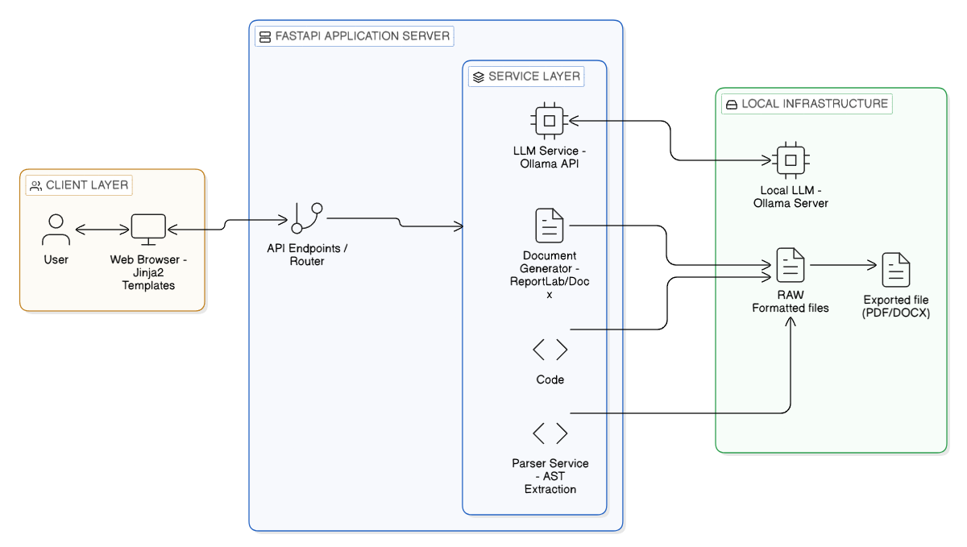
System Architecture Design

Slide 7
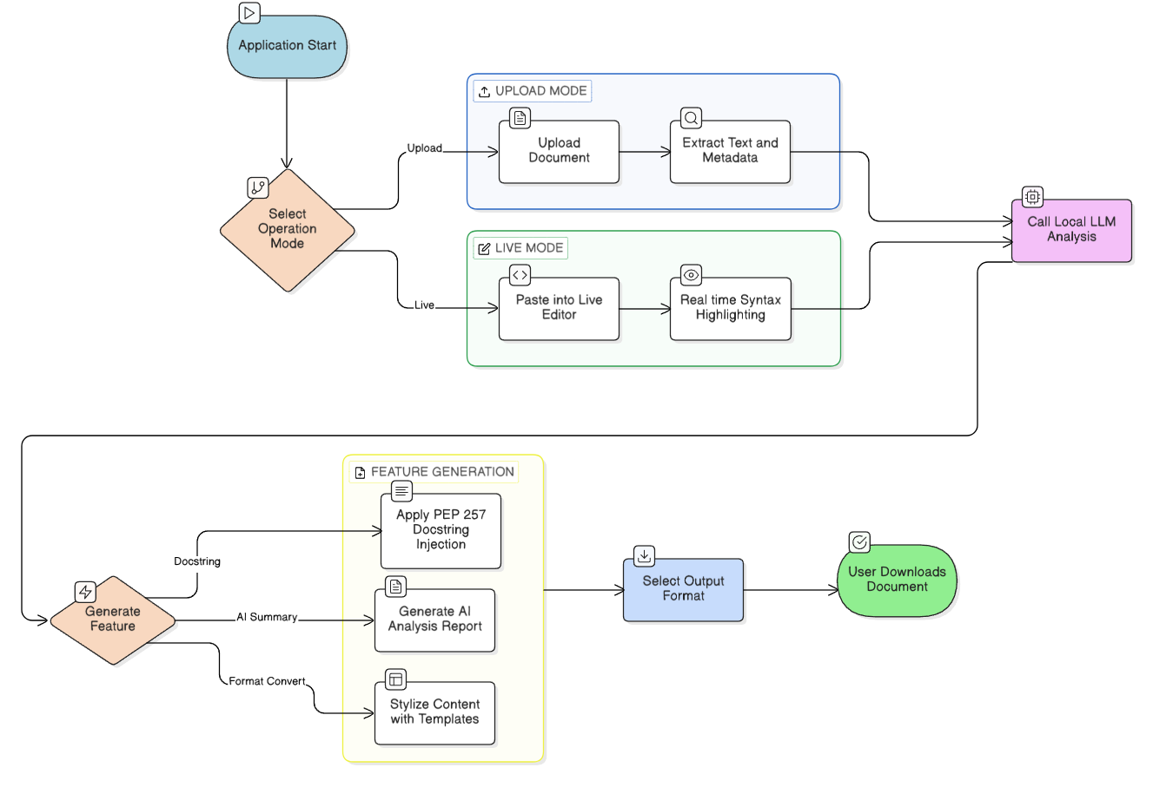
System Workflow

Slide 8
Technology Stack
Technology stack
Backend Framework | FastAPI
AI & Automation | Large Language Models (LLM):Ollama
System Automation | PyAutoGUI, Keyboard, & PyperClip
PDF Generation | ReportLab.
Word Processing | python-docx
Markdown Parsing | markdown-it-py & Pygment

Slide 9
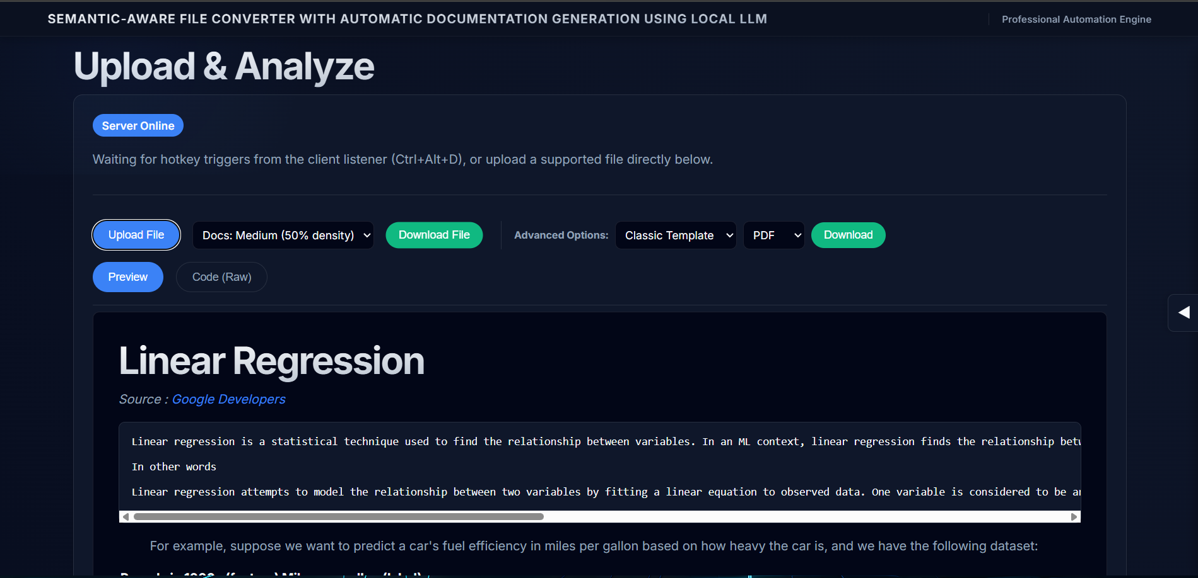
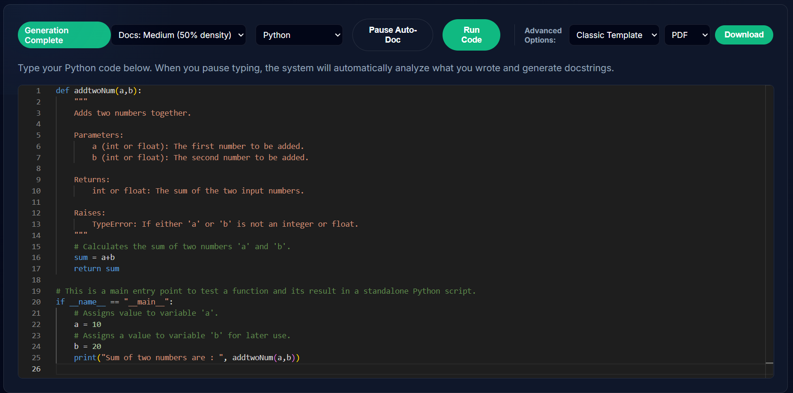
Demo and modes
Upload & Live Editor page
Upload & Analyze Page
Live Editor Page

Slide 10
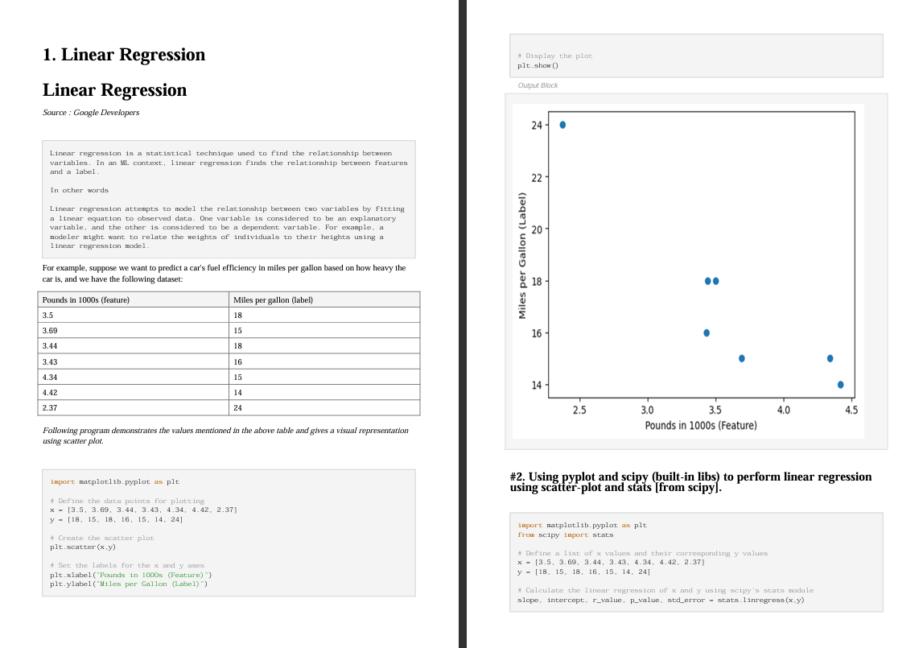
Demo and modes
Generated PDF output file from the original source .ipynb file

Slide 11
Future Enhancements
Implement direct CI/CD integration with GitHub Actions to automatically update documentation on every push.
Expand language support to include Go, Rust, and C++ for a more versatile multi-language documenter.
Integrate direct GitHub repository connection to automatically fetch and document entire source trees.
Enhance the visualization engine to automatically generate interactive Mermaid.js architectural diagrams from code.

Slide 12
Conclusion
AI-driven documentation bridges the gap between complex code and technical clarity. Our platform simplifies developer workflows by automating manual tasks with a premium, high-tech interface. Future enhancements like direct GitHub integration and Mermaid diagrams will further scale this innovation. We remain dedicated to ensuring technical knowledge is accurate, accessible, and effortlessly maintained.

Slide 13


